Slide 1


Advanced Mechanics of Materials ME EN 5300/6300
Department of Mechanical Engineering
University of Utah, Salt Lake City, UT, USA
Spring 2025
Instructor: Pai Wang

Slide 2

Course Overview
Icing on the Mechanics of Materials “cake”
Survey of advanced topics

Slide 3
What’s in the cake?
Fundamentals
stress, strain
material behavior / response
failure theory
Loading Modes – stress, displacement
axial loading
torsion
bending
combined loading

Slide 4
The “icing”: What problems do we solve?
Fundamentals
stress, strain
material response
failure theory
3-D
Loading Modes
beam bending – multiaxial; non-symmetric sections
torsion – non-circular sections
pressure vessels – thick-walled
column buckling
Limited to “simple” materials
Linear elastic
Homogeneous
Isotropic (mostly)
Survey of Advanced Topics
intro to Theory of Elasticity
energy methods
plasticity
plates and shells

Slide 5
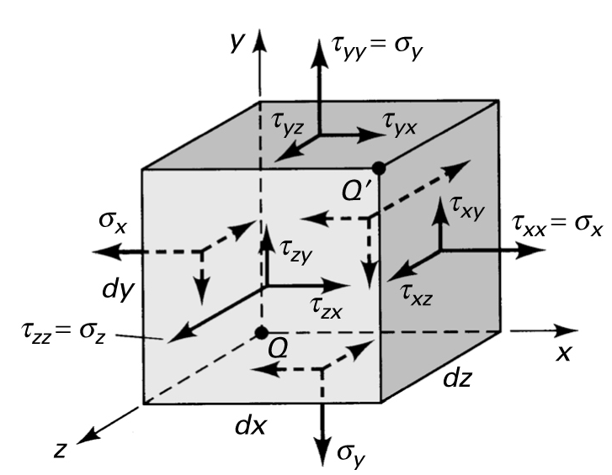
You will be able to …
evaluate complex stress/strain states and predict failure for various loading modes
identify limitations of elementary analysis techniques
utilize solutions from Theory of Elasticity for complex problems
apply energy methods to predict complex deformations
apply basic plasticity concepts

Slide 6
Rules for Learning
“This is a kind, brave, failure-tolerant classroom.”
Respect and work with the other students.
Ask questions.
Let me know how I can help you.
To foster lecture participation/interaction,
I will call on your names during lectures.

Slide 7
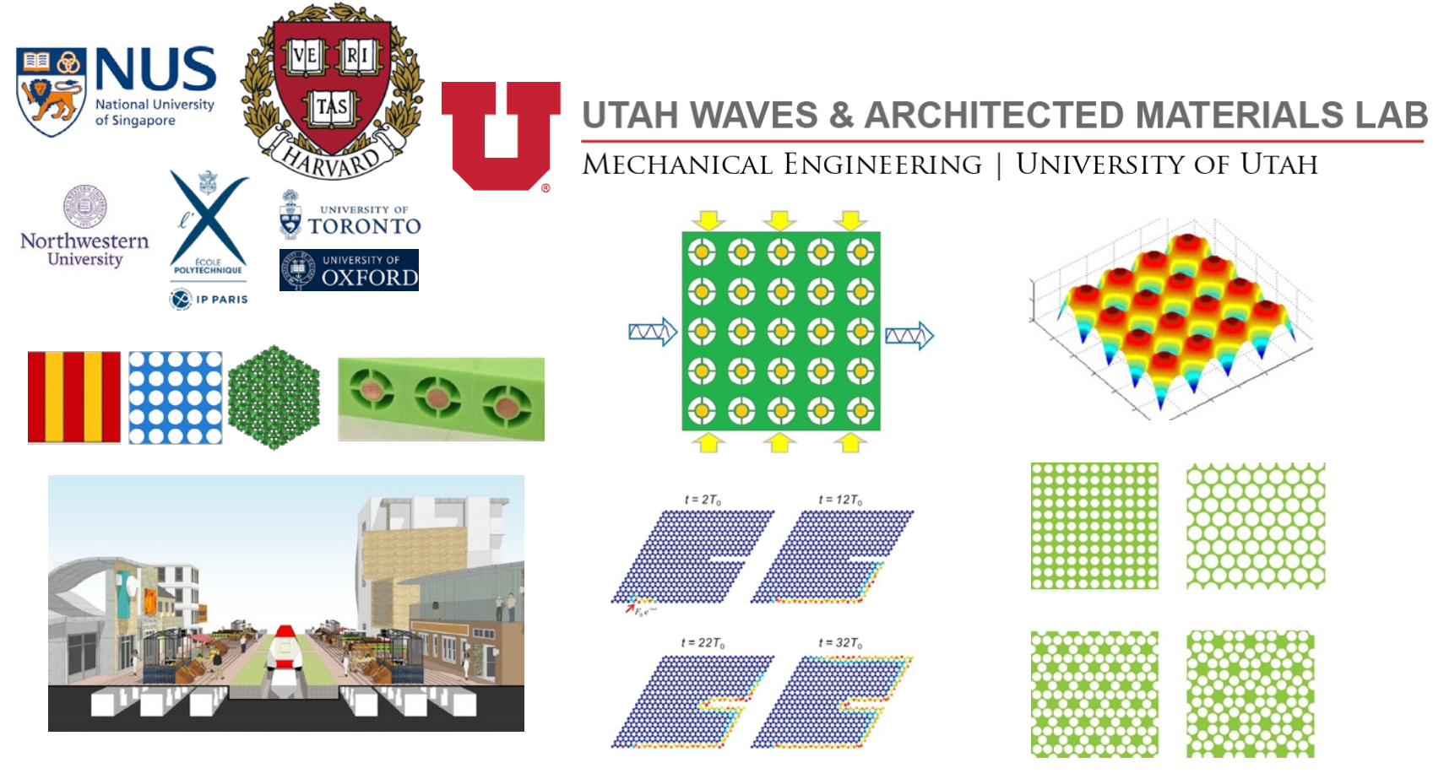
About Me

Slide 8
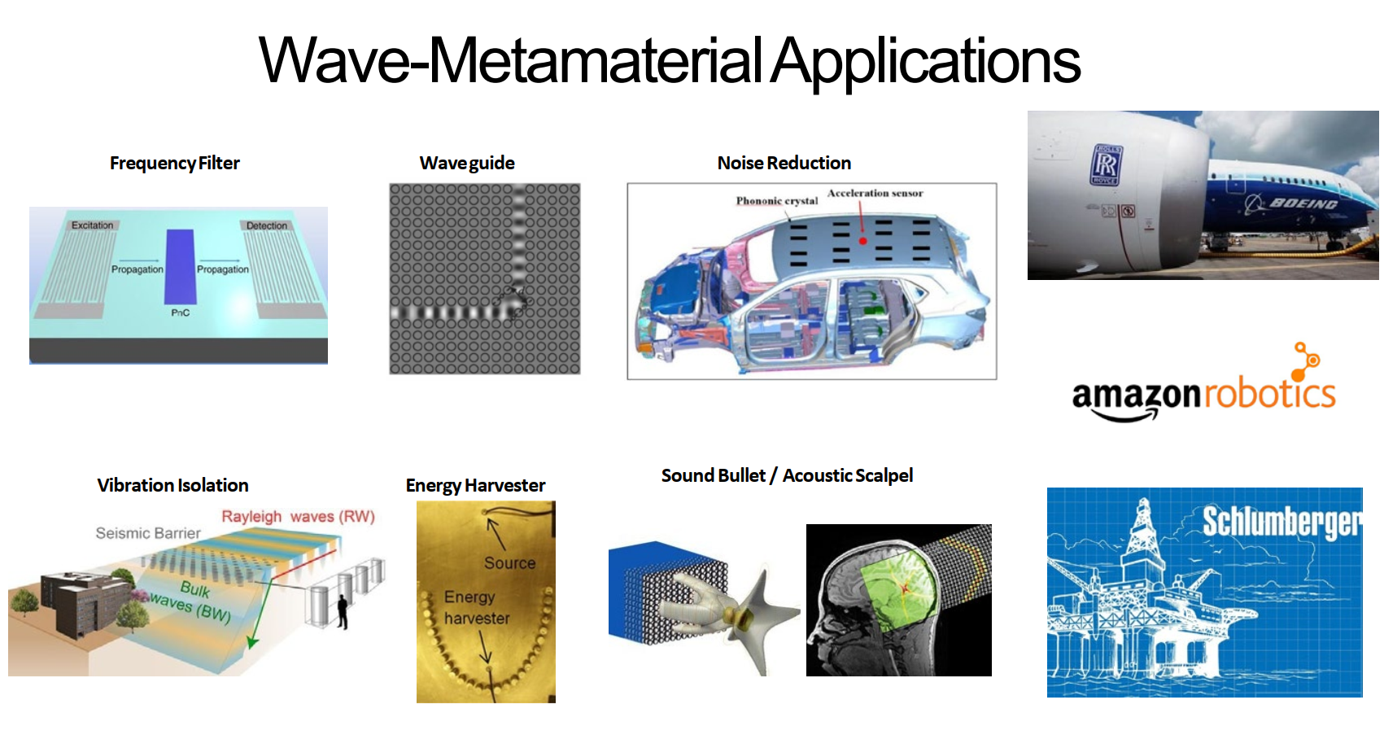
About Me

Slide 9
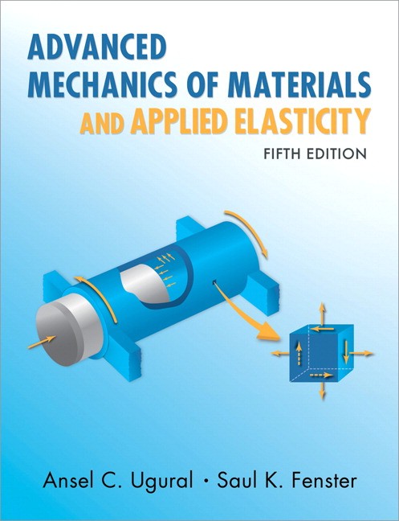
Nuts and Bolts
Pai Wang (pai.wang@utah.edu; MEK 2342)
Office hours: following lecture time; Or by appointment via email
Grader – Erik Langlo (erik.langlo@utah.edu)
Text: Advanced Mechanics of Materials and Applied Elasticity, 5th Ed., A.C. Ugural & S.K. Fenster, Prentice Hall, 2012
Online version freely available through Marriott Library website!!
Not error-free (errata listing on Canvas)
Great for reading and for this course
Alternative reference: https://solidmechanics.org
Great for finding things quickly

Slide 10
Canvas and Syllabus
Canvas
Course managed using Canvas
Make sure you are set up to receive notifications
Syllabus
posted on Canvas; will be updated, as needed, as semester proceeds
note exam dates; no alternate dates are available, so make sure these work for you

Slide 11
Grading and Homework
Grading
Class Participation 5%
Homework 15%
Three midterm exams, each 15%
Final exam 35%
Homework (see syllabus for schedule)
Due weekly at 11:59 PM on Thurs (covering material from previous week’s lectures)
Turn in electronically on Gradescope (linked to Canvas)
Late HW not accepted

Slide 12

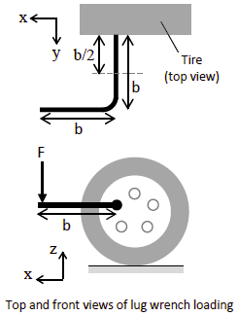
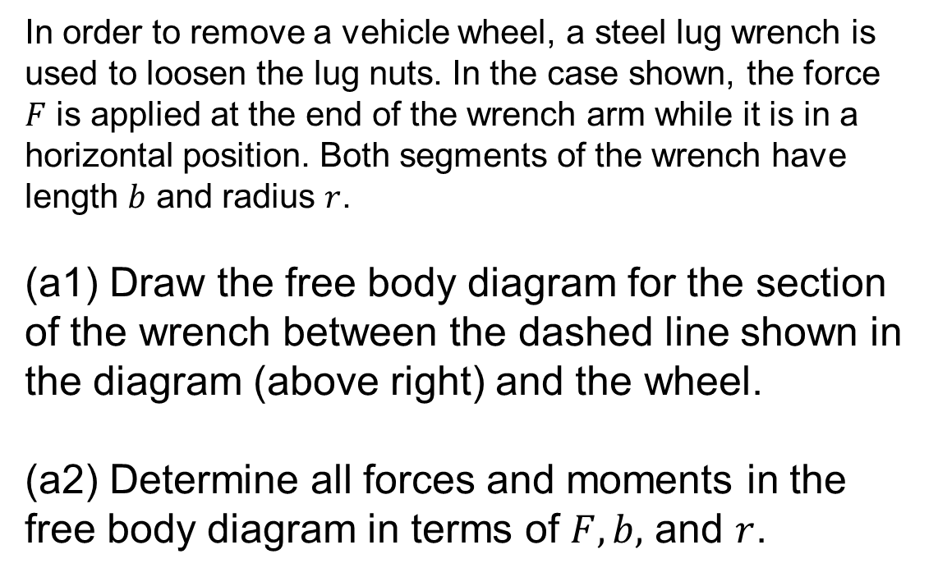
Let’s start with an example
In order to remove a vehicle wheel, a steel lug wrench is used to loosen the lug nuts. In the case shown, the force $F$ is applied at the end of the wrench arm while it is in a horizontal position. Both segments of the wrench have length $b$ and radius $r$.
(a1) Draw the free body diagram for the section of the wrench between the dashed line shown in the diagram (above right) and the wheel.
(a2) Determine all forces and moments in the free body diagram in terms of $F,b,$ and $r$.

Slide 13
Example
(b) Draw the state of stress for the element located at Point A (located on the top surface of the rod). Find the values of each of the non-zero stresses in terms of the applied loads and dimensions.
(c) Repeat for Point B
* Could continue to find principal stresses, evaluate failure, etc

Slide 15
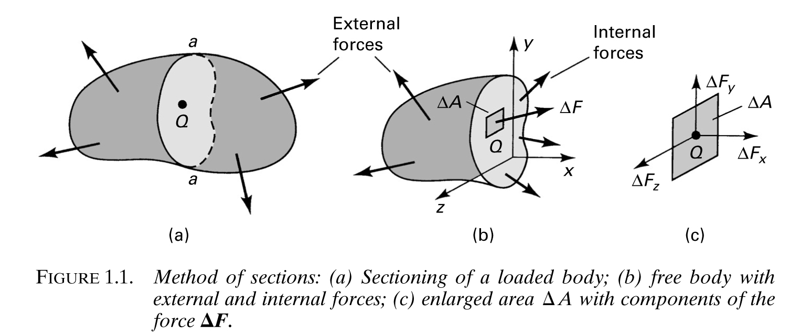
Force
Internal v. external force
Two sources of force: surface tractions; body forces (usually neglect latter)
Equilibrium: applies to whole body; sectioning
Free body diagrams

Slide 16
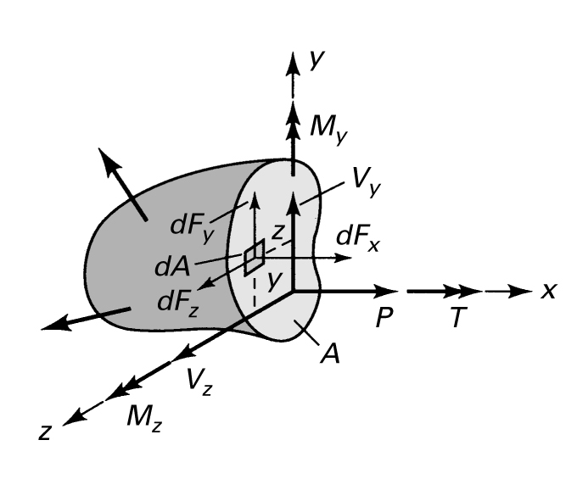
Force – Conventions
Right hand rule
Normal v. shear forces
Torques v. moments

Slide 17
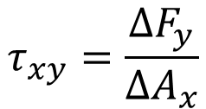
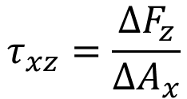
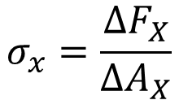
Stress
$$σ_{x}=\frac{{ΔF}_{X}}{{ΔA}_{X}}$$
$$τ_{xy}=\frac{{ΔF}_{y}}{{ΔA}_{x}}$$
$$τ_{xz}=\frac{{ΔF}_{z}}{{ΔA}_{x}}$$
Shear stress subscripts:
first refers to surface acting on
second to direction

Slide 18
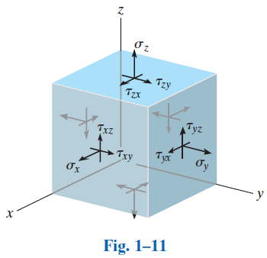
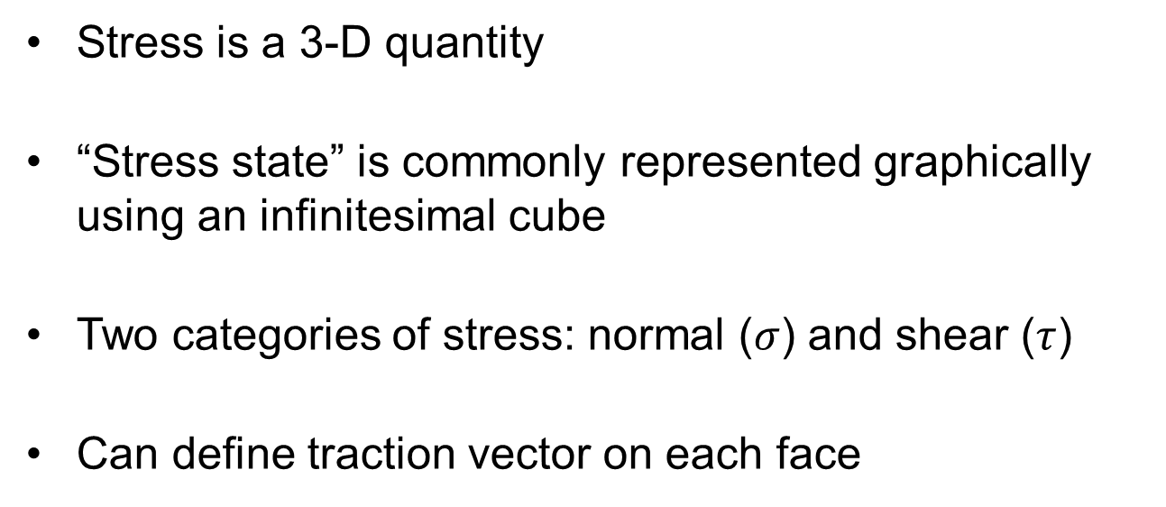
Stress
$$T_{z}$$
Stress is a 3-D quantity
“Stress state” is commonly represented graphically using an infinitesimal cube
Two categories of stress: normal ($σ$) and shear ($τ$)
Can define traction vector on each face
$$T_{y}$$
$$T_{x}$$
$$T_{x}=σ_{x}n_{x}+τ_{xy}n_{y}+τ_{xz}n_{z}$$
$$T_{y}=τ_{yx}n_{x}+σ_{y}n_{y}+τ_{yz}n_{z}$$
$$T_{z}=τ_{zx}n_{x}+τ_{zy}n_{y}+σ_{z}n_{z}$$
Components depend on coordinate system (like all vectors/tensors)

Slide 19
Stress Tensor
$$T_{x}=σ_{x}n_{x}+τ_{xy}n_{y}+τ_{xz}n_{z}$$
$$T_{y}=τ_{yx}n_{x}+σ_{y}n_{y}+τ_{yz}n_{z}$$
$$T_{z}=τ_{zx}n_{x}+τ_{zy}n_{y}+σ_{z}n_{z}$$
Stress is a second-order tensor (and can be represented as a matrix)
$$\left[σ_{ij}\right]=\left[\begin{matrix}σ_{x} & τ_{xy} & τ_{xz} \\ τ_{yx} & σ_{y} & τ_{yz} \\ τ_{zx} & τ_{zy} & σ_{z}\end{matrix}\right]$$
A vector is a first-order tensor
Again, components depend on coordinate system
Always symmetric (e.g., $τ_{xy}=τ_{yx}$, etc)
6 possible unique components; 3 normal, 3 shear

Slide 20
Stress Tensor
$$\left[τ\right]=\left[\begin{matrix}τ_{xx} & τ_{xy} & τ_{xz} \\ τ_{yx} & τ_{yy} & τ_{yz} \\ τ_{zx} & τ_{zy} & τ_{zz}\end{matrix}\right]$$
=$\left[\begin{matrix}σ_{x} & τ_{xy} & τ_{xz} \\ τ_{yx} & σ_{y} & τ_{yz} \\ τ_{zx} & τ_{zy} & σ_{z}\end{matrix}\right]$
Defining stress state is equivalent to defining components of stress tensor
Indicial notation (Einstein summation convention): τ_{ij}

